Slide 1
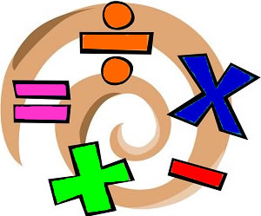

Challenge
2016

Slide 2
What is Challenge 2016?
Challenge 2016 is a whole school maths challenge
The challenge is to make the numbers from 1 – 100 using only the digits 2, 0, 1 and 6.
Anyone can submit a solution
Solutions will be displayed
on the Challenge 2016 board

Slide 3
Challenge 2016 instructions
You may use any mathematical symbol/operation (x, +, -, ÷, square root, decimal point, brackets, factorial (!), raising to a power (^) etc.) Tip: 0! = 1.
For each number you must use ALL four of the digits, 2, 0, 1 and 6. They can be used in any order.
You can combine digits to make larger numbers, e.g. you can make 20 from the 2 and the 0, so 20 + 1 + 6 is fine to make 27.
NB if you raise to a power, this power must be one of the four digits.
Remember BIDMAS!

Slide 4
Challenge 2016 instructions
Hand your solution(s) to your teacher or in to the Maths office along with your name and tutor group.
First come, first served! The first solution handed in for each number will be the one that goes on display.
How many can you find?!

Slide 5
